Slide 1
MongoDB Scans
Deepak Srinivasan

Slide 2
Index
1. MongoDB Scan
2. Stage : COLLSCAN Before Index creation
3. Stage : COLLSCAN After Index creation

Slide 3
1. MongoDB Scan
A collection scan occurs where no index can satisfy the query and we have to scan the full collection in order to find the required documents.
Without indexes, MongoDB must perform a collection scan, i.e. scan every document in a collection, to select those documents that match the query statement. If an appropriate index exists for a query, MongoDB can use the index to limit the number of documents it must inspect.
MongoDB uses multikey indexes to index the content stored in arrays. If you index a field that holds an array value, MongoDB creates separate index entries for every element of the array. These multikey indexes allow queries to select documents that contain arrays by matching on element or elements of the arrays.

Slide 4
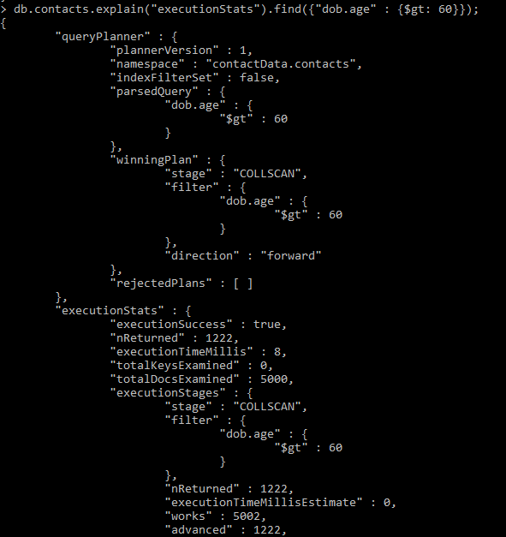
2. Stage : COLLSCAN Before Index creation

Slide 5
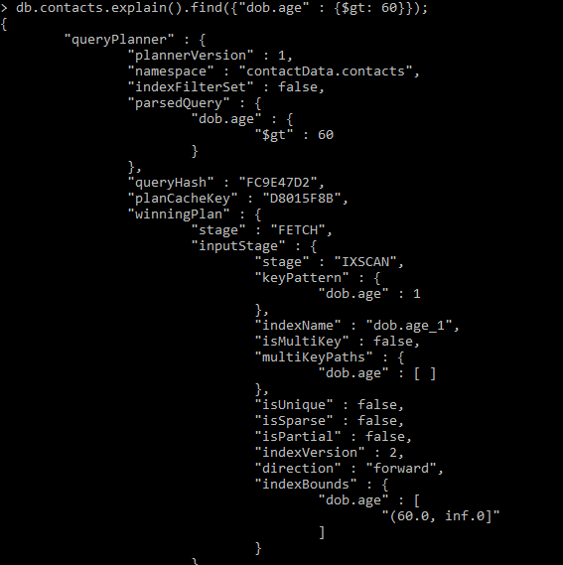
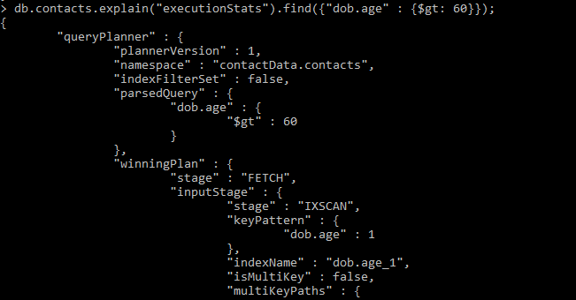
3. Stage : IXSCAN After Index creation

